Slide 1

Whole
Performers
THE NEXT STAGE OF HUMAN DEVELOPMENT
IN LEADERSHIP, WORK AND THE FUTURE
PETER MERRY

Slide 2
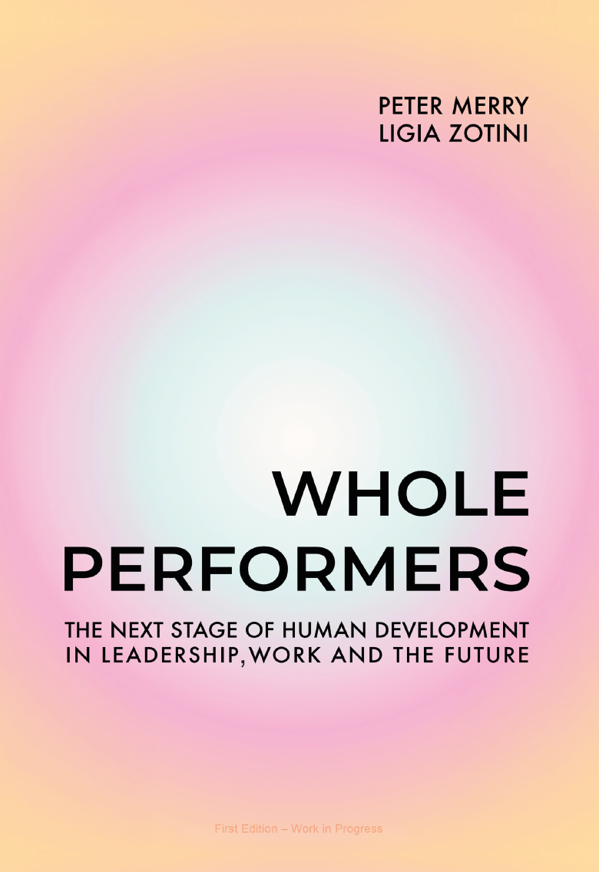
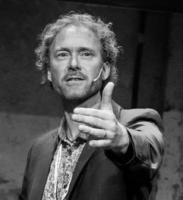
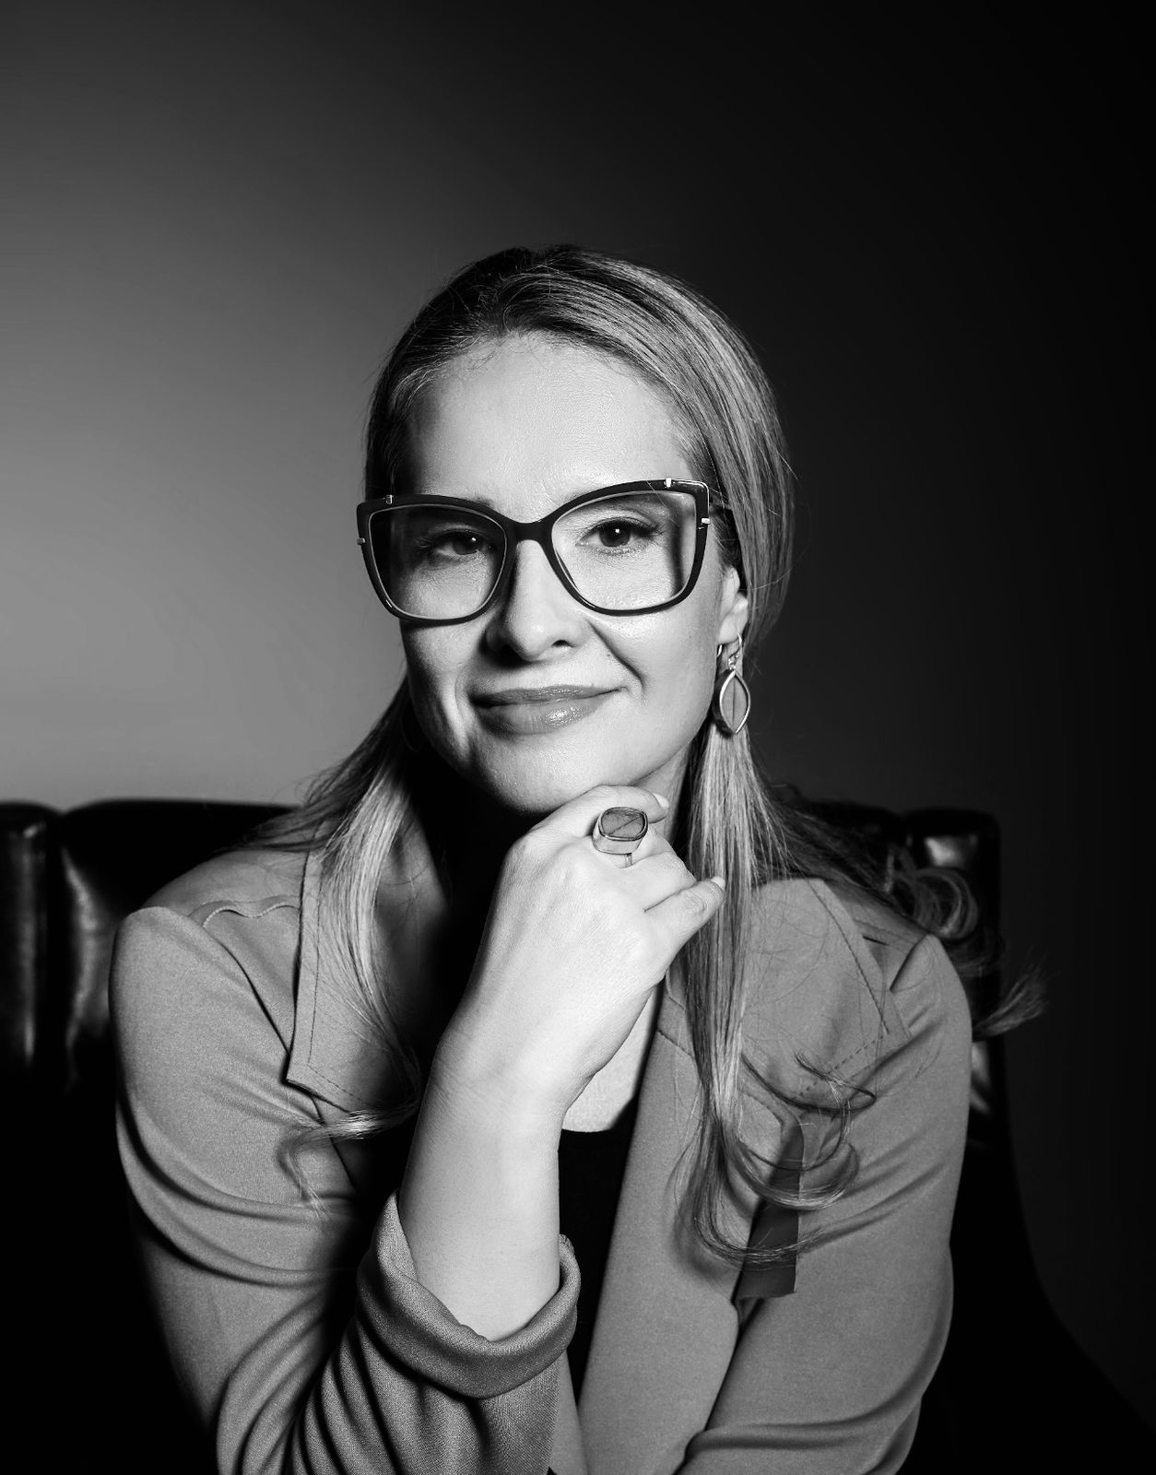
Co-authors
Peter Merry is a social entrepreneur, author, and trainer, and a globally recognised expert in transformative leadership, working with governments, CEOs, and civil society leaders.
Ligia Zotini is a futures researcher, speaker, and author, designing future scenarios at the intersection of technology, humanity, and emerging ecosystems.
@wholeperformers

Slide 3
Understanding the labor market in the context
of human and societal development
01
What are we
going to cover
What today's world is demanding
02
?
The gifts and limits of High Performers
03
The promise of Whole Performers
04

Slide 4
01
Understanding the Labor Market in the Context of Human and Societal Development

Slide 5
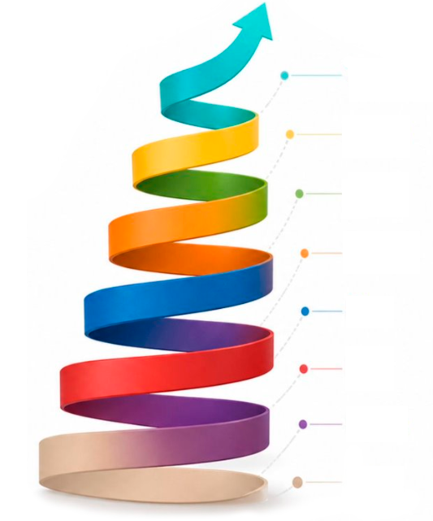
01 · Understanding
the Labor Market
Stages of Development
Turquoise
Yellow
1
2
3
Green
People and
societies evolve
Greater
complexity
Life conditions
Orange
People and societies evolve and express themselves through stages of development.
Each new stage is able to deal with more complexity than the previous ones.
A stage develops and activates in us as a response to life conditions.
Blue
Red
Purple
Beige
Model reference: Spiral Dynamics

Slide 6
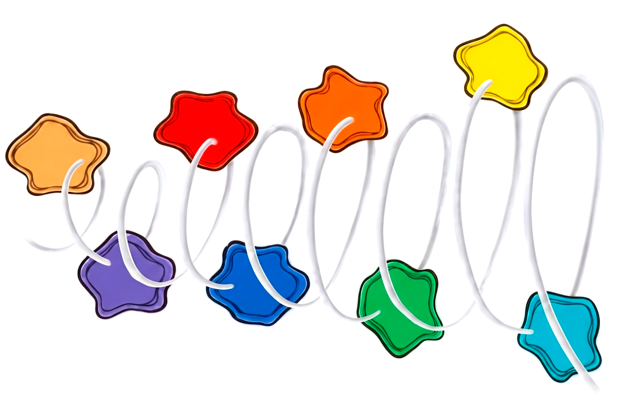

01 · Understanding
the Labor Market
Spiral Dynamics —
A Bio-Psycho-Social Model
Orange
Yellow
Achiever self
Integral self
Red
Power Self
Beige
Survival Self
Second tier of Memes
First tier of Memes
Purple
Blue
Magic Self
Conformist Self
Green
Sensitive Self
Turquoise
Holistic Self
Source: Evolutionary Leadership by Peter Merry

Slide 7
01 · Understanding
the Labor Market
Spiral Dynamics —
A Bio-Psycho-Social Model
Orange
Yellow
Industrial Phase
Integral Phase
Red
Warior Phase
Beige
Hunter-gatherer Phase
Second tier of Memes
First tier of Memes
Purple
Blue
Tribal Phase
Agrarian Phase
Green
Post-Industrial
Phase
Turquoise
Planetary Phase
Source: Evolutionary Leadership by Peter Merry

Slide 8
01 · Understanding
the Labor Market
Integral
Fitness
INTERIOR
EXTERIOR
I
IT
INDIVIDUAL
Self
Behavior & Organism
Individual Interior
Individual Exterior
All 4 dimensions co-develop
WE
ITS
COLLECTIVE
Webs of Culture
Systems & Structures
Collective Interior
Collective Exterior
Source: Integral Theory, Ken Wilber

Slide 9
02
What Today's World
Is Demanding

Slide 10
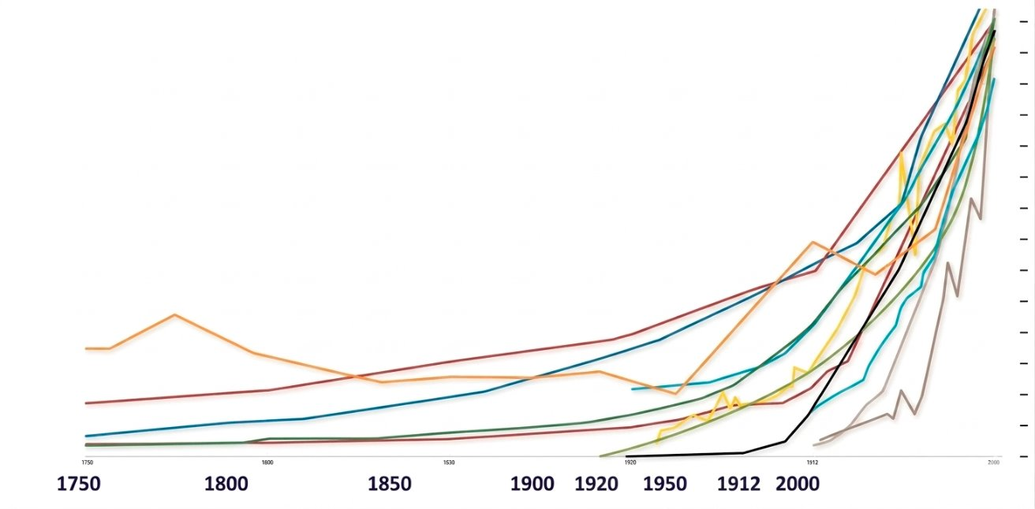
02 · What Today's World is Demanding
Hyper-Complexity:
The Life Conditions
We Face Today
Species Extinction
Digitalization
Global Warming
Forest Loss
Pollution
Water Use
Population Growth
Investment
Source: Adapted from New Scientist

Slide 11
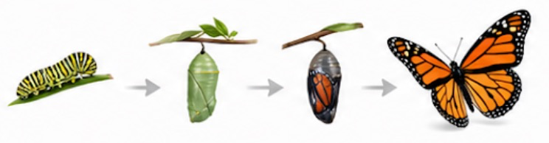
02 · What Today's World is Demanding
Non-Linear Emergence
Human Sociotechnological Evolution
Territorial Spread
B
Level of organization Structural Complexity Specifc entropy
B
Contemporary
Post-industrial
B
Modern
Industrial
B
B = Bifurcations (technology-driven revolutions)
Classical
Feudal
B
Archaic
Agricultural
Neolithic
Agrarian-pastoral
Paleolithic
Hunting-gathering
Time
Source: Ervin Laszlo · Evolutionary Leadership by Peter Merry

Slide 12
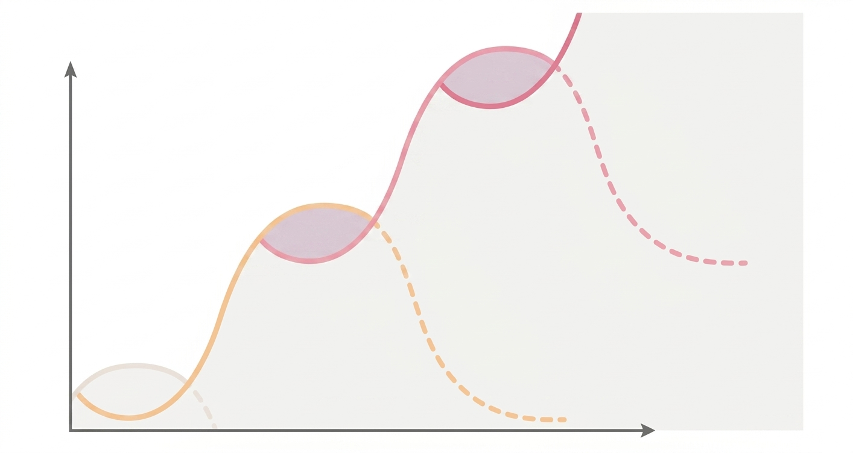
02 · What Today's World is Demanding
We Are in
an Era of
Non-Linear
Change
Fitness
Chaos
New
Letting Come
Letting Go
Chaos
Emergence
Old
Emergency
Time
Source: Evolutionary Leadership by Peter Merry

Slide 13
03
The Gifts and Limits
of High Performers

Slide 14
High Performers are an expression of the Orange Achiever Self
03 · The Gifts and Limits of High Performers
Orange
Yellow
Achiever self
Integral self
Red
Power Self
Beige
Survival Self
Second tier of Memes
First tier of Memes
Purple
Blue
Magic Self
Conformist Self
Green
Sensitive Self
Turquoise
Holistic Self
Source: Evolutionary Leadership by Peter Merry

Slide 15
03 · The Gifts and Limits of High Performers
Orange — Achiever Self
Achievement, autonomy, success and innovation
Core Drive
Strengths
Watch-outs
Workplace
Thrives on challenge and opportunity
To achieve, improve and win
Can become overly individualistic
Entrepreneurial and ambitious
Freedom to pursue results
Values autonomy, targets & recognition
Strategic, practical and goal-focused
May chase status, growth & performance at any cost
Rational problem-solving and merit
Innovative, data-driven and effective
Drives progress, productivity and measurable impact
Can neglect wellbeing, relationships & purpose
Healthy expression: purposeful achievement in service of real value.

Slide 16
03 · The Gifts and Limits of High Performers
What High Performers Have Brought Us
Ambition, discipline, growth and breakthrough results
Core Contribution
Value Created
Workplace Strengths
Impact it Made
Strong drive to achieve
Greater productivity and efficiency
Built modern organisations & markets
Clear targets and accountability
Focus on goals, standards & execution
Innovation, enterprise and competitiveness
High energy, initiative and resilience
Solved problems at scale
Commitment to measurable results
Wealth creation and expanded opportunity
Momentum for change & performance
Raised expectations of what people can do
Enduring contribution: high performers helped build the progress, prosperity and innovation of the modern world.

Slide 17
03 · The Gifts and Limits of High Performers
The Limits of High Performers
When performance is detached from wholeness, its hidden costs begin to show
Human Costs
Cultural Costs
Strategic Limits
Systemic Impact
Burnout, stress and exhaustion
Competition overrides trust and collaboration
Short-term results vs long-term health
Success can deepen inequality & exclusion
Identity tied too tightly to doing and winning
People valued mainly for output and status
Complexity reduced to what can be measured
Growth can come at social & ecological cost
Neglect of rest, relationships and inner life
Fear of failure can narrow learning and honesty
Reflection, inclusion and wisdom are undervalued
Organisations lose resilience, meaning and humanity
Key insight: high performance alone is no longer enough for the complexity and humanity of the future.

Slide 18
04
The Promise of
Whole Performers

Slide 19
Whole Performers are an expression of the Yellow Integral Self
03 · The Gifts and Limits of High Performers
Orange
Yellow
Achiever self
Integral self
Red
Power Self
Beige
Survival Self
Second tier of Memes
First tier of Memes
Purple
Blue
Magic Self
Conformist Self
Green
Sensitive Self
Turquoise
Holistic Self
Source: Evolutionary Leadership by Peter Merry

Slide 20
04 · The Promise of Whole Performers
Yellow — Integral Self
Integration, systemic thinking, flexibility and purposeful complexity
Workplace
Core Drive
Strengths
Watch-outs
Thrives in complex, fast-changing environments
To understand, integrate and evolve
Systemic, adaptive and integrative
Can seem detached or overly conceptual
Freedom to respond to complexity
Comfortable with paradox & uncertainty
Values autonomy, learning & collaboration
May overcomplicate decisions
Seeks coherence across perspectives and systems
Sees patterns, interdependencies and leverage points
Can struggle to communicate simply to others
Strategic integration, innovation, whole-system thinking
Healthy expression: wise integration in service of whole-system flourishing.

Slide 21
The difference between the High Performer and Whole Performer is the Green Sensitive Self
03 · The Gifts and Limits of High Performers
Orange
Yellow
Achiever self
Integral self
Red
Power Self
Beige
Survival Self
Second tier of Memes
First tier of Memes
Purple
Blue
Magic Self
Conformist Self
Green
Sensitive Self
Turquoise
Holistic Self
Source: Evolutionary Leadership by Peter Merry

Slide 22
04 · The Promisse of Whole Performers
Green — Sensitive Self
Connection, empathy, equality and shared meaning
The Step from Orange Achiever to Yellow Integral is Green Sensitive Self
Core Drive
Strengths
Watch-outs
Workplace
To connect, care and include
Compassionate, collaborative and supportive
Can avoid conflict or hard decisions
Thrives in participative, values-led cultures
Meaningful relationships and shared values
May over-prioritise harmony & consensus
Values teamwork, purpose, appreciation
Values fairness, listening and inclusion
Authenticity, empathy and participation
Builds trust, belonging & psychological safety
Can lose effectiveness through indecision or blurred boundaries
Brings engagement, care and people-centred leadership
Healthy expression: caring connection in service of growth, inclusion and shared wellbeing.

Slide 23
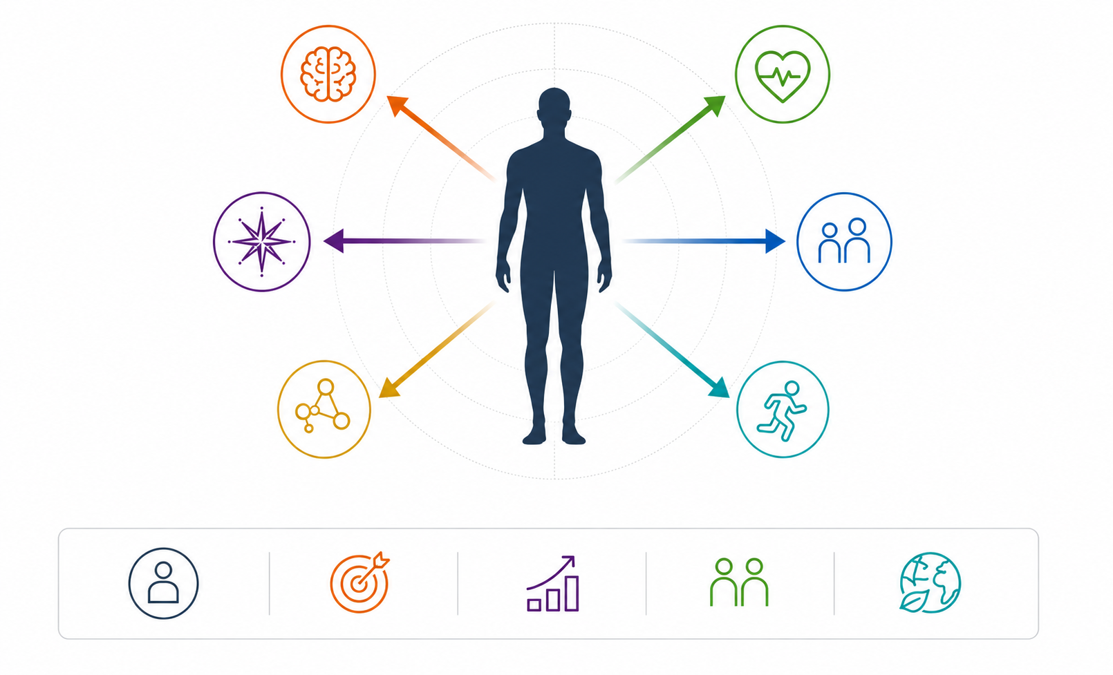
04 · The Promise of
Whole Performers
Cognitive
Emotional
The
Spectrum
of Human
Intelligence
Self-awareness, empathy and emotional regulation
Analytical thinking, learning, reasoning, and problem-solving
Intuitive
Relational
Pattern recognition, insight and inner knowing
Building trust, collaboration, communication and meaningful relationships
Systems
Somatic
Understanding complexity, connections and how things work together
Body awareness, health, energy and physical well-being
Better decisions
Greater
adaptability
Deeper
connections
Sustainable
Impact
Human intelligence is multidimensional.
When we integrate all domains, we unlock our full potencial.

Slide 24
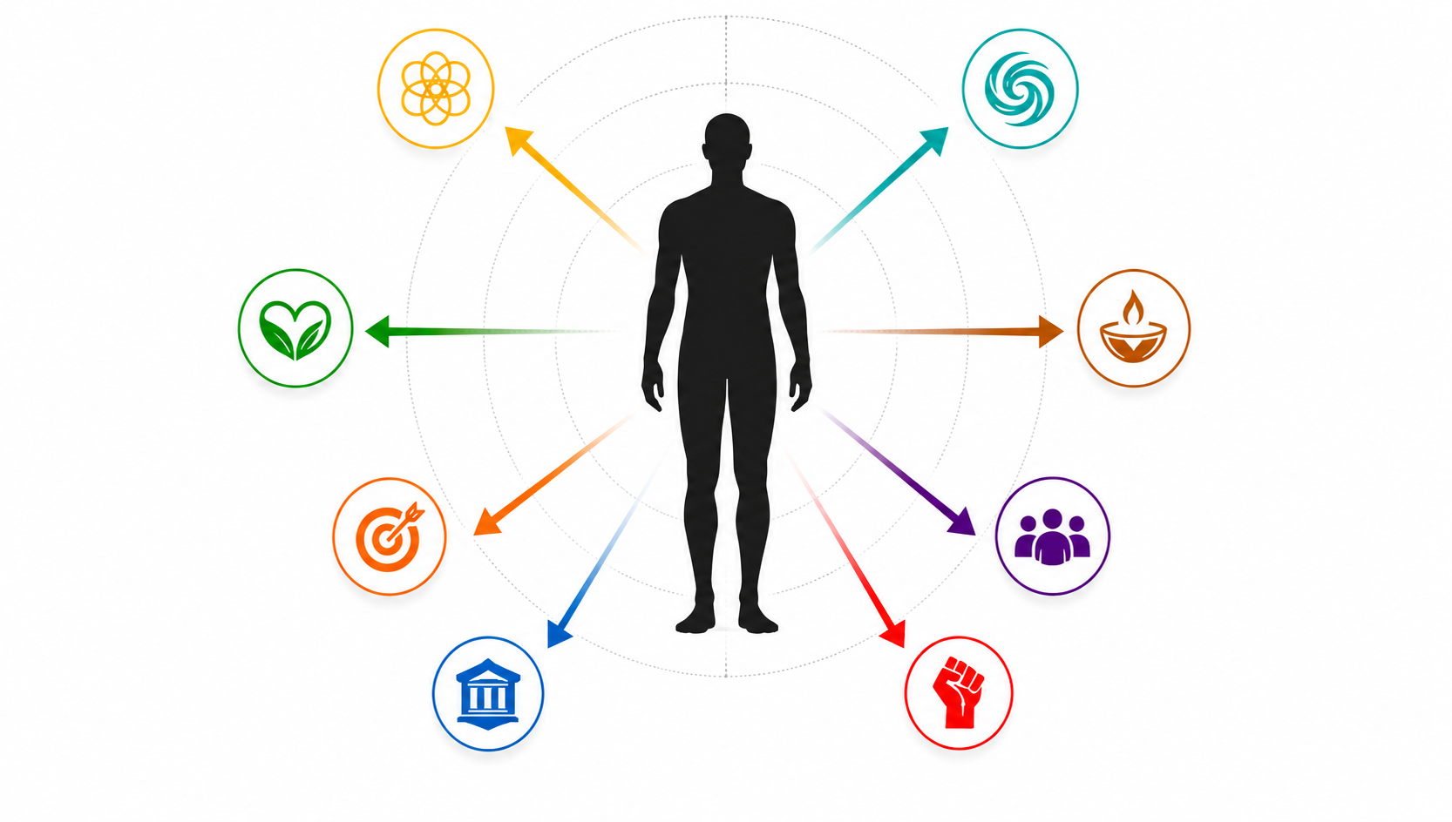
04 · The Promise of
Whole Performers
Wholeness
Integration
The Whole Performer Accesses
a Full Spectrum of Value Systems
Living in alignment with purpose, values and inner harmony.
Bringing ideas, people and system together
Survival
Meeting basic needs, staying safe and enduring.
Care
Nurturing, suporting
And promoting
Well bein
Belongin
Achiement
Connecting, being, accepted and contributing.
Setting goals, striving, and accomplishing meaningful results.
Order
Power
Creating structure, rules and stability in systems.
Influencing, leading and creating positive impact.

Slide 25
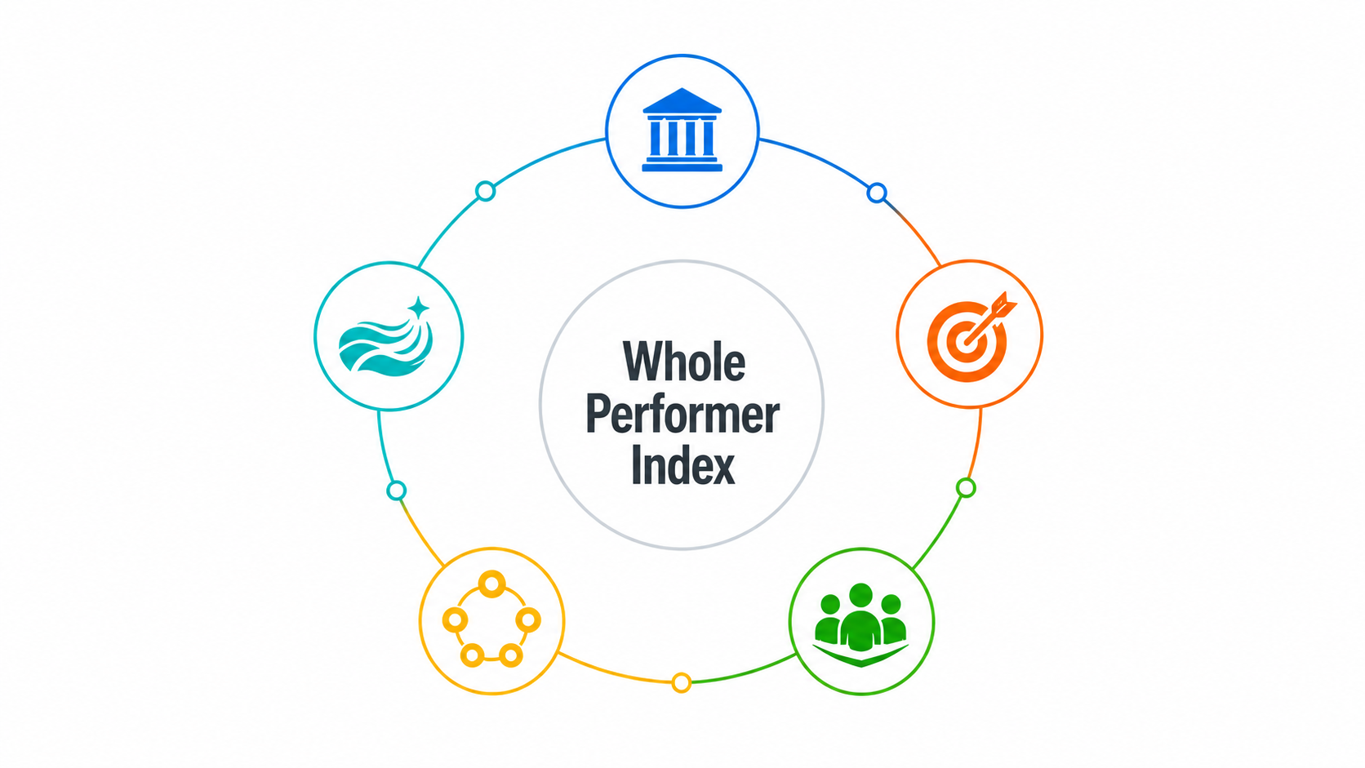
04 · The Promise of
Whole Performers
The Whole Performer Index
Structural Clarity
Form · Roles · Reliability
Flow-Based Action
Timing · Emergence · Presence
Strategic Drive
Goals · Initiative · Delivery
Systems Integration
Empathic Collaboration
Trust · Conflict · Collective Intelligence
Patterns · Polarities · Root Causes

Slide 26
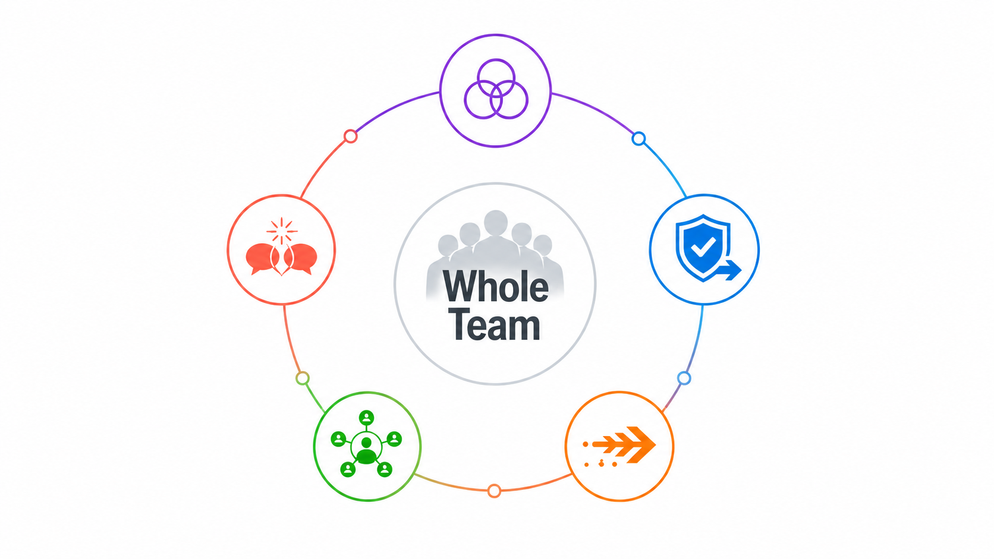
Whole Teams
04 · The Promise of
Whole Performers
Developmental Fluency
Mixed Values · Translation ·Range
Safe & Decisive
Trust · Clarity · Decisions
Generative Conflict
Difference · Truth · Learning
Collective Intelligence
Coherent Action
Inquiry · Shared Insight ·Reflexivity
Alignment · Accountability ·Adaptation

Slide 27
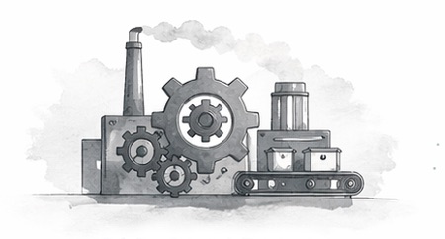
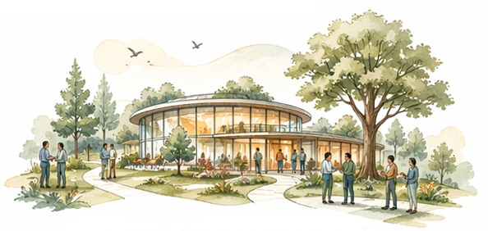
04 · The Promise of
Whole Performers
Whole Organisations
From machine for performance to living architecture for human contribution
WHOLE ORGANISATION
OLD PARADIGM
Purposeful
Control
→
Coherent
Fragmentation
Short-term focus
Adaptive
Developmental
People as resources
Regenerative
Culture
Role Architecture
Decision Structures
Development
Trust, honesty, psychological safety
Clear contribution, flexible fit
Distributed intelligence, clear accountability
Change and growth tracked & supported

Slide 28
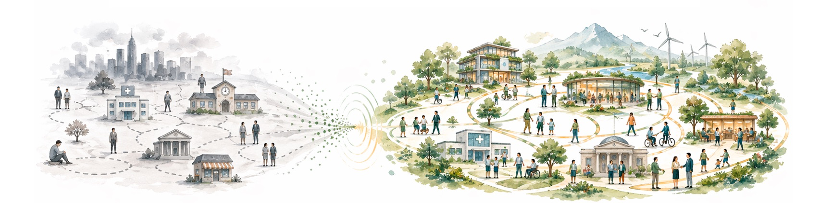
04 · The Promise of
Whole Performers
Implications for Society
When whole people, teams, and organisations become more common, society itself begins to evolve.
Healthier People
Stronger Communities
Wiser Institutions
Regenerative Economy
Living Planet
More wellbeing, less burnout
More trust, belonging, participation
More adaptive, human-centred systems
Value creation with long-term stewardship
Work and society aligned with ecology
The journey toward Whole Performers may become part of the journey toward a whole society.

Slide 29
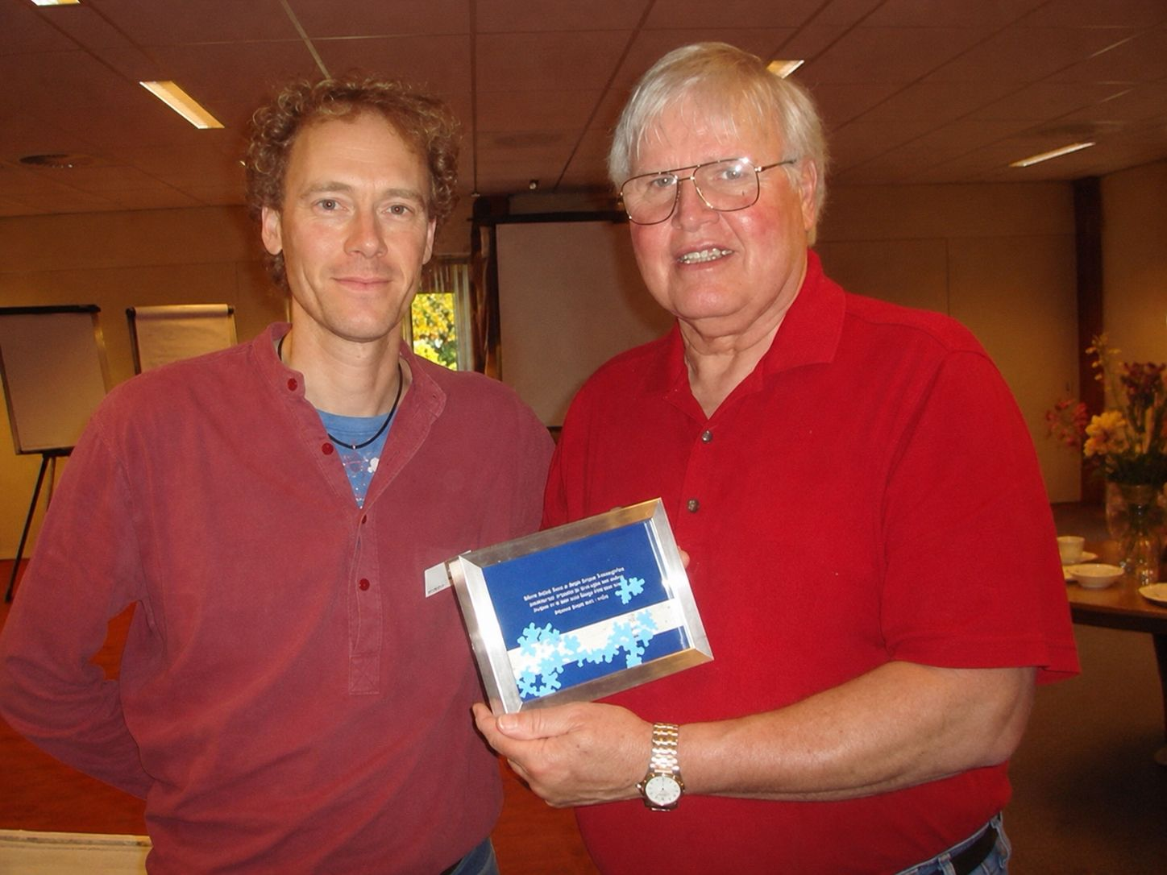
“No more prizes for predicting the rain. Only prizes for building the arks.”
DR DON BECK
Peter Merry and Don Beck, 2008

Slide 30
Are you
Ready?

Slide 31
Are you ready?
To let go of this
20,000 year eddy,
which we know is just an undertow.
We be tuning into
The Real Flow
Here Now
You can’t compute
The impact of
this Swile Experience institute.
It’s like taking off
The Mute
On the voice of life,
Stepping onto the
Edge of the knife
A slice
Of how humans might be.

Slide 32
Can you see
What we have done?
Can you see
What we have begun?
This the form
Which holds the storm.
We feel the creature of
Learning
Burning
Invite the world in
It ain’t no sin
She is turning at
40000 miles an hour,
That’s a fact.
That’s power.

Slide 33
The big bang,
rang,
sang,
Echoing on to the mount
A blast from the past
At last!
Too much to count
The years of evolution
The earth, the human
Sufferin’ and compassion
We’re boomin’!
That’s a fusion
Of chaos and confusion
Away from the illusion
Of wealth,
Our revolution
is coming with stealth …

Slide 34
Can you see what we have done?
Can you see what we have begun?
Do we dare
To share
The future of how humans might be?
Do we dare to be free
Do I dare to be me?
To be fully human
To love confusion and drop the illusion?
Now we’re boomin’!
Do we dare to step
Into the places we most fear?
become clear?
To find a community
True to me.

Slide 35
I’m not being cute
There’s no parachute
We already jumped
out the plane.
Do we dare to become
Sane
Again?
This ain’t about brain
This is about livin’
the future now
Yes is the answer to how.
We movin’, we groovin’
But stop,
Listen to me:

Slide 36
Can you see
What we have done?
Can you see
What we have begun?
My sisters and brothers
from other mothers,
We are the ones
Where the ocean
meets the shore,
We are the ones
We have been waiting for.
(Tim Merry)

Slide 37

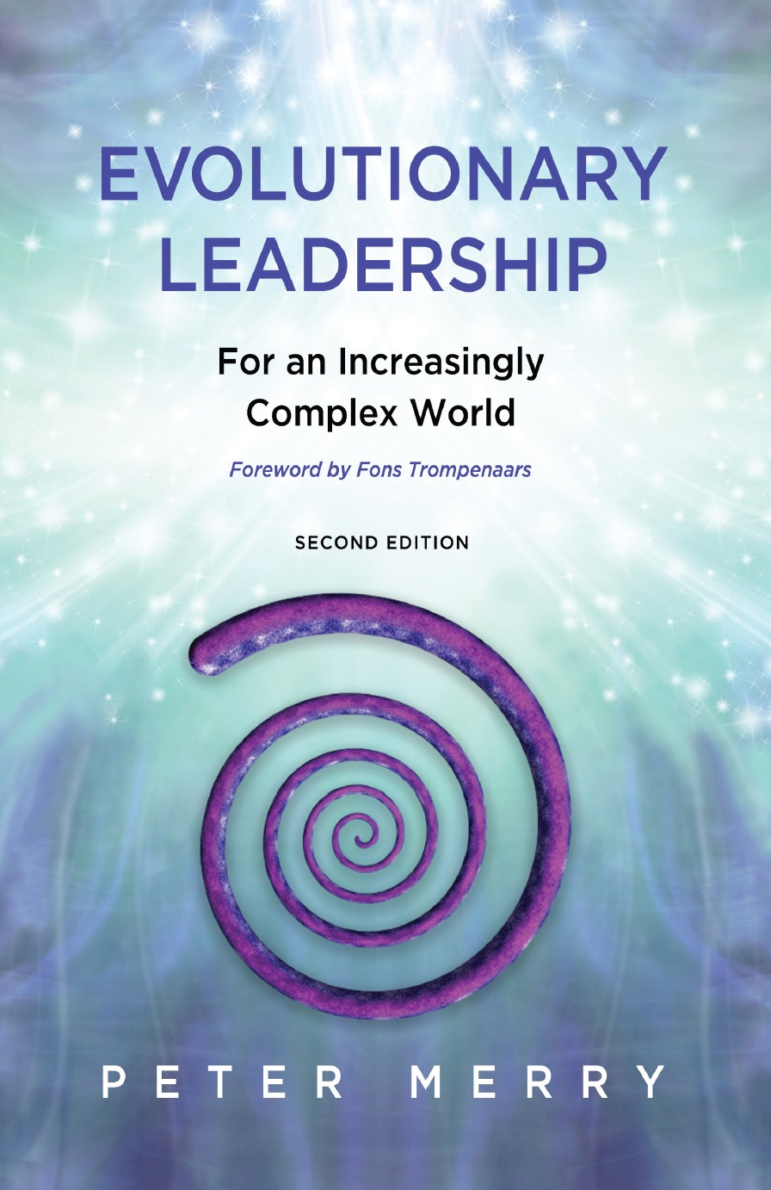
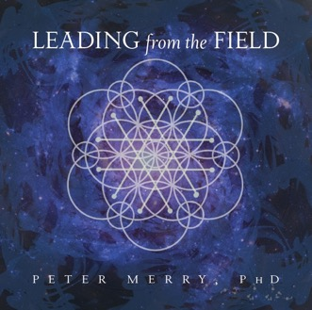
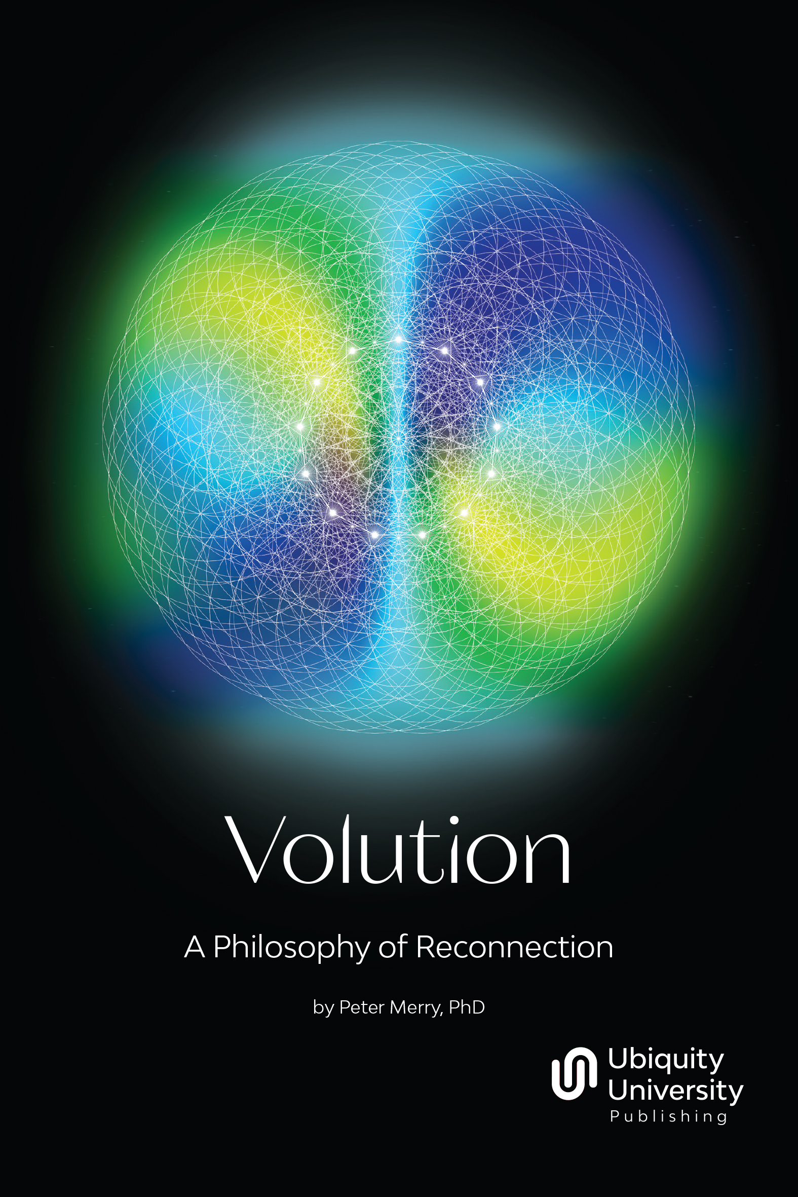

"Sink your roots deep,
reach for the heavens,
open your heart and
do what needs to be done."
Connect with
Peter Merry
https://petermerry.org
peter@petermerry.org

Slide 38
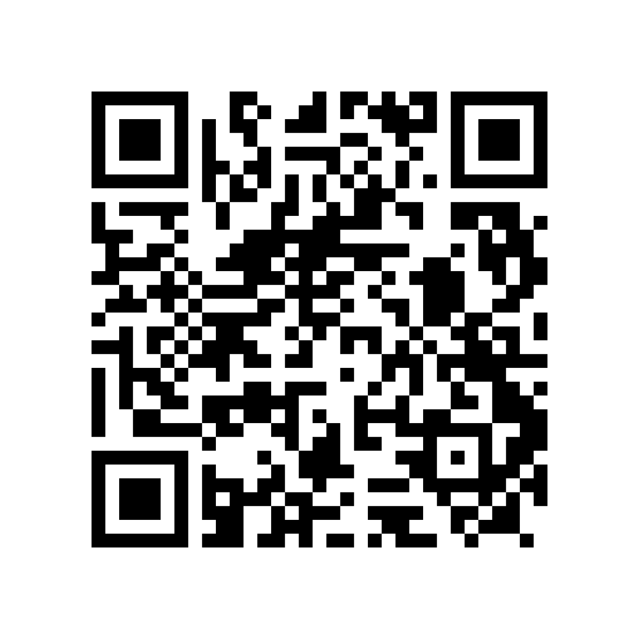
New Human(s) Brazilian Mission
Application to the Annual Science & Consciousness event with Peter Merry

Slide 39

Leadership
20.70
powered by novos humano(s)
Education, Research, Information

